Slide 1


PRINCIPLES OF MANAGEMENT & PROFESSIONAL ETHICS
SUBJECT CODE - SBA1101
UNIT - II

Slide 2


UNIT – II - MANAGEMENT OF ORGANISATION
Forms of Business / Industrial Ownership – Sole Trader, Partnership, Joint stock Company, Performance Appraisal – Basic Principles – Pitfalls – Methods to Overcome, Industrial Safety – Causes of Accidents – Cost of Accidents – Measures to avoid accidents. Plant Layout & Maintenance – Need , Types and Managerial Aspects.

Slide 3
BUSINESS ORGANISATION - INTRODUCTION
Business means the activities which involve production of wealth.
A business is defined as an organization or enterprising entity engaged in commercial, industrial, or professional activities. ... The term "business" also refers to the organized efforts and activities of individuals to produce and sell goods and services for profit.
A business is an enterprise which distributes or provides an article or services which other members of the community need and are able and willing to pay for it. Business organization refers to all those steps that need to be undertaken for establishing relationship between men, material, and machinery to carry on business efficiently for earning profits.

Slide 4
Characteristics of Business Organisation:
1. Ownership: refers to the right of an individual or a group of individuals to acquire legal title to assets or properties for the purpose of running the business. A business firm may be owned by one individual or a group of individuals jointly.
2. Lawful Business: Every business enterprise must undertake such business which is lawful, that is, the business must not involve activities which are illegal.
3. Status and Management: Every business undertaking is an independent entity. It has its own assets and liabilities. It has its own way of functioning. The profits earned or losses incurred by one firm cannot be accounted for by any other firm.
4. Dealing in goods and services: Every business undertaking is engaged in the production and/or distribution of goods or services in exchange of money.
5. Continuity of business operations: All business enterprise engage in operation on a continuous basis. Any unit having just one single operation or transaction is not a business unit.
6. Risk involvement: Business undertakings are always exposed to risk and uncertainty. Business is influenced by future conditions which are unpredictable and uncertain.

Slide 5
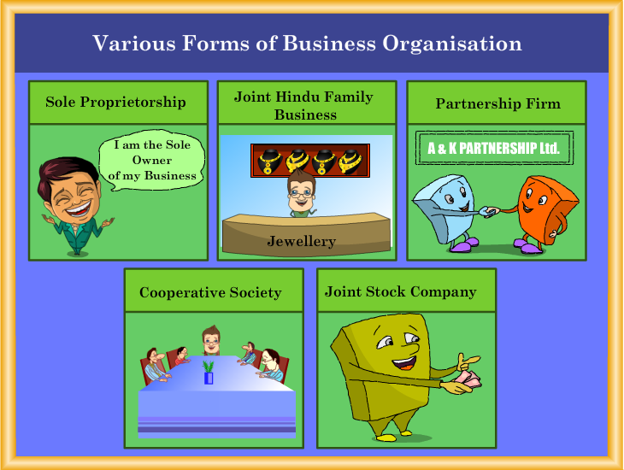

Slide 6

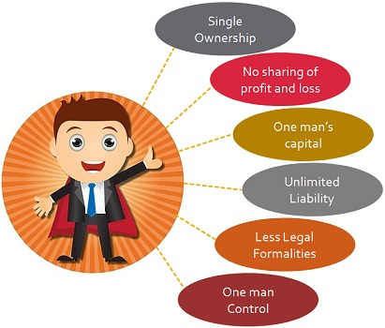
A sole proprietorship is the oldest and the most common form of business. It is a one-man organization where a single individual owns, manages and controls the business.
CHARACTERISTICS OF SOLE PROPRIETORSHIP:

Slide 7



Ownership: The business enterprise is owned by one single individual . The individual has got legal title to the assets and properties of the business. The entire profit arising out of business goes to the sole proprietor. Similarly, he also bears the entire risk or loss of the firm.
Management: The owner of the enterprise is generally the manager of the business.
He has got absolute right to plan for the business and execute them without any interference from anywhere. He is the sole decision maker.
Source of Capital: The entire capital of the business is provided by the owner.
In addition to his own capital he may raise more funds from outside through borrowings from close relatives or friends, and through loans from banks or other financial institutions.

Slide 8


Legal Status: The proprietor and the business enterprise are one and the same in the eyes of law. There is no difference between the business assets and the private assets of the sole proprietor.
Liability: The liability of the sole proprietor is unlimited. This means that, in case the sole proprietor fails to pay for the business obligations and debts arising out of business activities, his personal property can be used to meet those liabilities.

Slide 9

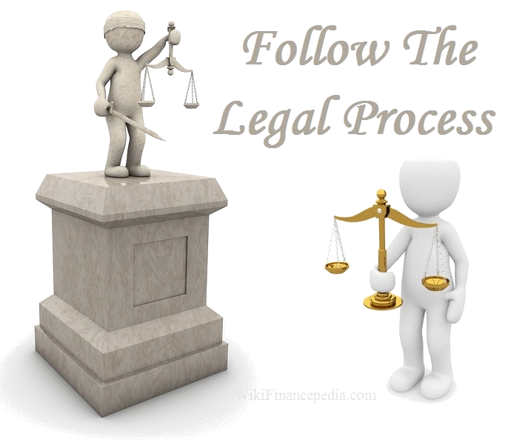
Stability: The stability and continuity of the firm depend upon the capacity, competence and the life span of the proprietor.
Legal Formalities: In the setting up, functioning and dissolution of a sole proprietorship business no legal formalities are necessary. However, a few legal restrictions may be there in setting up a particular type of business. For example, to open a restaurant, the sole proprietor needs a license from the local municipality

Slide 10
ADVANTAGES OF SOLE PROPRIETORSHIP
Easy Formation: The sole trader business is easy to form. Anybody wishing to start such a business can do so without any legal formalities.
Better Control: The owner has full control over his business. He plans, organizes, co-ordinates the various activities. Since he has all authority, there is always effective control.
Prompt Decision Making: The decision making becomes quick, which enables the owner to take care of available opportunities immediately and provide immediate solutions to problems.
Flexibility in Operations: One man ownership and control makes it possible for change in operations to be brought about as and when necessary.

Slide 11

Retention of Business Secrets: The owner is in a position to maintain absolute secrecy regarding his business activities.
Direct Motivation: The owner alone is the beneficiary of the profits .
Personal Attention to Consumer Needs: proprietor taking personal care of consumer needs as he normally functions within a small geographical area.
Creation of Employment: A sole trader business facilitates self-employment and also employment for many others.

Slide 12
DISADVANTAGES OF SOLE PROPRIETORSHIP
Unlimited Liability: The liability of business is recovered from the personal assets of the owner. It restricts the sole trader to take more risk and increases the volume of his business.
Limited Financial Resources: The ability to raise and borrow money by one individual is always limited. The inadequacy of finance is a major handicap for the growth of sole proprietorship.
Limited Capacity of Individual: An individual has limited knowledge and skill. Thus his capacities to undertake responsibilities, his capacity to manage, to take decisions and to bear the risks of business are also limited.
Uncertainty of duration: The existence of a sole trader business is linked with the life of the proprietor. Illness, death or insolvency of the owner brings an end to the business. The continuity of business operation is, therefore, uncertain.

Slide 13


A partnership form of organization is one where two or more persons are associated to run a business with a view to earn profit. Persons from similar background or persons of different ability and skills, may join together to carry on a business. Each member of such a group is individually known as partner and collectively the members are known as a partnership firm. These firms are governed by the Indian Partnership Act, 1932.

Slide 14
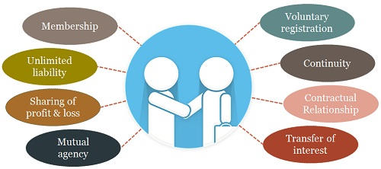
CHARACTERISTICS OF PARTNERSHIP

Slide 15



Number of Partners: A minimum of two persons are required to start a partnership business. The maximum membership limit is 10 in case of banking business and 20 in case of all other types of business.
Contractual Relationship: The partners enter into partnership through an agreement which may be verbal, written or implied. If the agreement is in writing it is known as a Partnership Deed.
Competence of Partners: Since individuals have to enter into a contract to become partners, they must be competent enough to do so. Thus, minors, lunatics and insolvent persons are not eligible to become partners. However, a minor can be admitted to the benefits of partnership i.e. he can have a share in the profits.

Slide 16

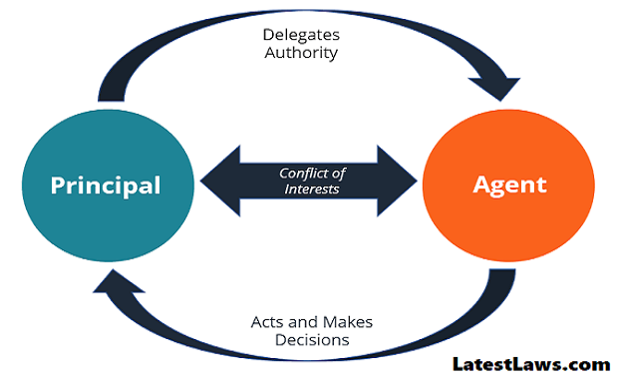

Sharing of Profit and Loss: The partners can share profit in any ratio as agreed. In the absence of an agreement, they share it equally.
Principal-Agent Relationship: The business in a partnership firm may be carried on by all the partners or any one of them acting for all. It is, therefore, essential that there should be mutual trust and faith among the partners in the interest of the firm.
Transfer of Interest: No partner can sell or transfer his interest in the firm to anyone without the consent of other partners

Slide 17


Voluntary Registration: Registration of partnership is not compulsory. But since registration entitles the firm to several benefits, it is considered desirable. For example, if it is registered, any partner can file a case against other partners, or a firm can file a suit against outsiders in case of disputes, claims, disagreements, etc.
Dissolution of Partnership: Dissolution of partnership implies not only a complete closure or termination of partnership business, but it also includes any change in the existing agreement among the partners due to a change in the number of partners.

Slide 18
ADVANTAGES OF PARTNERSHIP
Easy Formation: A partnership can be formed without many legal formality and expenses. Every partnership firm need not be registered.
Larger Resources: As compared to sole proprietorship, a partnership firm can pool larger financial resources. Thus it can enter into bigger operations and can have more credit facilities. It can also have better managerial talent.
Flexibility in operation: Flexibility is due to a limited number of partners. These partners can change their operations and objectives if necessary by mutual consent.
Better Management: Partners take more interest in the affairs of business as there is a direct relationship between ownership, control and profit. They often meet to discuss the affairs of business and can take prompt decision.

Slide 19

Sharing of Risk: In partnership, risk of loss is easier to bear by individual partners as it is shared by all the partners.
Better Public Relations: In a partnership firm the group managing the affairs of the firm is generally small. It facilitates cordial relationship with the public.

Slide 20

DISADVANTAGES OF PARTNERSHIP
Instability: A partnership firm does not continue to exist indefinitely. The death, insolvency or lunacy of a partner may bring about an unexpected end to partnership.
Lack of Harmony: Since every partner has equal right, there are greater possibilities of friction and quarrel among the partners. Differences of opinion may lead to mistrust and disharmony which may ultimately result in disruption and closure of the firm.
Limited Capital: As there is a restriction on the maximum number of partners, the capital which can be raised is limited.
PARTNERSHIP

Slide 21
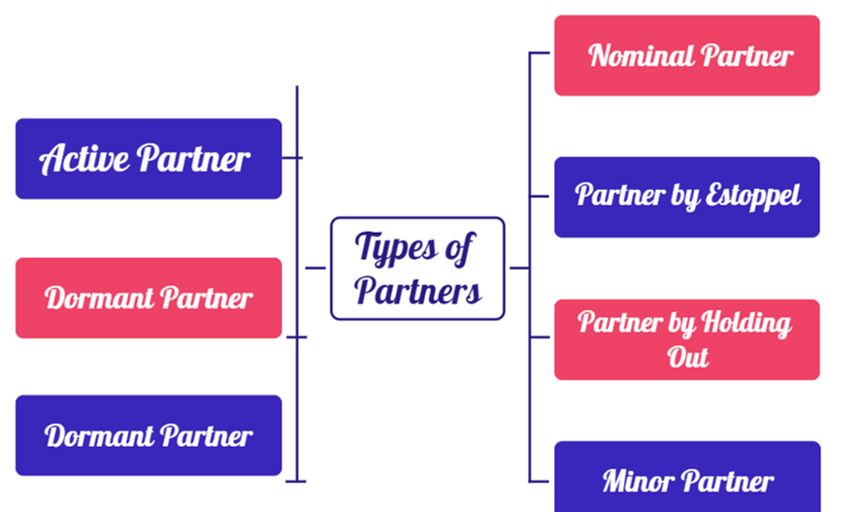

Slide 22
TYPES OF PARTNERS
1. Active or managing partner:
A person who takes active interest in the business of the firm is known as active or managing partner. He carries on business on behalf of the other partners. If he wants to retire, he has to give a public notice of his retirement; otherwise he will continue to be liable for the acts of the firm.
2. Sleeping or dormant partner:
A sleeping partner does not take active part in the management of the business. Such a partner only contributes to the share capital of the firm, is bound by the activities of other partners, and shares the profits and losses of the business.
3. Nominal or ostensible partner:
A nominal partner is one who does not have any real interest in the business but lends his name to the firm, without any capital contributions, and doesn’t share the profits of the business. He also does not usually have a voice in the management of the business

Slide 23
4. Partner by Estoppel :
He is a person who by his words (spoken or written) or conduct represents himself as a partner. Such a partner becomes liable to those who advance money to the firm under the impression that he is a partner in the firm.
5. Partner in profits only:
When a partner agrees with the others that he would only share the profits of the firm and would not be liable for its losses, he is in own as partner in profits only.
6. Minor as a partner:
A partnership is created by an agreement. And if a partner is incapable of entering into a contract, he cannot become a partner. Thus, at the time of creation of a firm a minor (i.e., a person who has not attained the age of 18 years) cannot be one of the parties to the contract. But under section 30 of the Indian Partnership Act, 1932, a minor ‘can be admitted to the benefits of partnership’, with the consent of all partners.

Slide 24
Secret partner. The position of a secret partner lies between active and sleeping partner. His membership of the firm is kept secret from outsiders. His liability is unlimited and he is liable for the losses of the business. He can take part in the working of the business.
Sub-Partner:
A partner may associate anybody else in his share in the firm. He gives a part of his share to the stranger. The relationship is not between the sub-partner and the firm but between him and the partner. The sub-partner is a non-entity for the partnership. He is not liable for the debts of the firm.

Slide 25

JOINT STOCK COMPANY / PUBLIC LIMITED COMPANY
A public limited company is a voluntary association of members which is incorporated and, therefore has a separate legal existence and the liability of whose members is limited.

Slide 26
CHARACTERISTICS OF JOINT STOCK COMPANY
Separate Legal Entity: Being an artificial person, a company has an existence independent of its members. It can own property, enter into contract and conduct any lawful business in its own name
Common Seal: Every company has a common seal by which it is represented while dealing with outsiders. Any document with the common seal and duly signed by an officer of the company is binding on the company.
Perpetual Existence: A company once formed continues to exist as long as it fulfils the requirements of law. It is not affected by the death, lunacy, insolvency or retirement of any of its members.
Transferability of Shares: The members of a company are free to transfer the shares held by them to anyone else.

Slide 27
Formation: A company comes into existence only when it has been registered after completing the formalities prescribed under the Indian Companies Act 1956. A company is formed by the initiative of a group of persons known as promoters.
Membership: A company having a minimum membership of two persons and maximum fifty is known as a Private Limited Company. But in case of a Public Limited Company, the minimum is seven and the maximum membership is unlimited.
Management: Joint Stock Companies have democratic management and control. Even though the shareholders are the owners of the company, all of the them cannot participate in the management process. The company is managed by the elected representatives of shareholders known as Directors.
Capital: A Joint Stock Company generally raises a large amount of capital through issue of shares.

Slide 28



ADVANTAGES OF JOINT STOCK COMPANY
Limited Liability: In a Joint Stock Company the liability of its members is limited to the extent of shares held by them. This attracts a large number of small investors to invest in the company. It helps the company to raise huge capital.
Benefits of large scale operation: It is only the company form of organization which can provide capital for large scale operations. It results in large scale production consequently leading to increase in efficiency and reduction in the cost of operation. It further opens the scope for expansion.
Professional Management: Companies, because of complex nature of activities and operations and large volume of business, require professional managers at every level of organization. And because of their financial strength they can afford to appoint such managers. This leads to efficiency.

Slide 29


Social Benefit: A joint stock company offers employment to a large number of people. It facilitates promotion of various ancillary industries, trade and auxiliaries to trade.
Research and Development: A company generally invests a lot of money on research and development for improved processes of production, designing and innovating new products, improving quality of product, new ways of training its staff, etc.

Slide 30
DISADVANTAGES OF JOINT STOCK COMPANY
Formation is not easy: The formation of a company involves compliance with a number of legal formalities under the companies Act and compliance with several other Laws.
Control by a Group: Companies are controlled by a group of persons known as the Board of Directors.
Speculation and Manipulation: The shares of a company are purchased and sold on the stock exchanges. The value or price of a share is determined in terms of the dividend expected and the reputation of the company.
Excessive government control: A company is expected to comply with the provisions of several Acts. Non-compliance of these invites heavy penalty. This affects the smooth functioning of the companies.
Delay in Policy Decisions: A company has to fulfill certain procedural formalities before making a policy decision. These formalities are time consuming and, therefore, policy decisions may be delayed

Slide 31

PRIVATE LIMITED COMPANY
A private limited company is a voluntary association of not less than two and not more than fifty members, whose liability is limited, the transfer of whose shares is limited to its members and who is not allowed to invite the general public to subscribe to its shares or debentures.
A private company is preferred by those who wish to take the advantage of limited liability but at the same time desire to keep control over the business within a limited circle and maintain the privacy of their business

Slide 32

Advantages:
Limited Liability: It means that if the company experience financial distress because of normal business activity, the personal assets of shareholders will not be at risk of being seized by creditors.
Minimum number of shareholders need to start the business are only 2
More capital can be raised as the maximum number of shareholders allowed is 50.
Disadvantages :
The shares in a private limited company cannot be sold or transferred to anyone else without the agreement of other shareholders (not freely transferable
Not allowed to invite public to subscribe to its share

Slide 33
Basis | Sole Proprietorship | Partnership
1. Membership | Only one member | Minimum membership is two, maximum membership is ten incase of banking business twenty
2. Functioning | A sole trader manages his business at his | May be managed by all partners or
 | free will. | any one on behalf of all others.
3. Formation | Easy and can be formed at any time the owner decides. | An agreement is required between the partners to start a business.
4. Secrecy | Business secrets are not open to anyone other than the proprietor | Business secrets are open to every partner.
5. Finance | Scope for raising capital is limited | Scope for raising capital is relatively more.
6. Continuity of business | Comes to an end with the death of the sole trader. | The business of a firm does not come to an end if a partner leaves the firm.
7. Decision Making | Owner alone takes decision and so it is quick. | All partners must agree to important decisions and so decision making may take time.
8. Liability | Unlimited and burden is heavy | Unlimited but less burdensome as it is shared by partners.
DIFFERENCE B/W SOLE PROPRIETORSHIP AND PARTNERSHIP

Slide 34
Basis | Partnership | Joint Stock Company
1. Formation | It is easy to form as registration is not compulsory | It requires many legal formalities to be completed before the company comes into existence
2. Operation | Governed by the Partnership Act, 1932 | Governed by the companies Act, 1956
3. Membership | Minimum is two, maximum is 10 in banking business and 20 in other business. | In case of Private Company minimum is 2, maximum is 50; in case of Public company minimum is 7 and maximum unlimited.
4. Legal Status | No separate legal entity | Separate legal entity from that of its members
5. Liability | Joint and several to an unlimited extent | Limited to the value of shares held for limited companies
6. Management | All or any one on behalf of all partners is are entitled | Only the Board of directors authorized
7. Transfer of shares | Consent of all partners required | Shares are freely transferable
8. Existence | Dissolves with the death, retirement or insanity of a partner etc. | Perpetual existence, unaffected by death, retirement, insolvency of the shareholders
9. Finance | Relatively limited scope for raising finance | Vast and unlimited scope for raising finance
DIFFERENCE B/W PARTNERSHIP AND JOINT STOCK COMPANY

Slide 35
DISTINGUISH BETWEEN PUBLIC COMPANY AND PRIVATE COMPANY
1. Minimum Paid-up Capital: A company to be Incorporated as a Private Company must have a
minimum paid-up capital of Rs. 1,00,000, whereas a Public Company must have a minimum paid- up capital of Rs. 5,00,000.
2. Minimum number of members: Minimum number of members required to form a private company is 2, whereas a Public Company requires at least 7 members.
3. Maximum number of members: Maximum number of members in a Private Company is restricted to 50, there is no restriction of maximum number of members in a Public Company.
4. Transferability of shares: There is complete restriction on the transferability of the shares of a Private Company through its Articles of Association, whereas there is no restriction on the transferability of the shares of a Public company.

Slide 36
Issue of Prospectus: A Private Company is prohibited from inviting the public for subscription of its shares, i.e. a Private Company cannot issue Prospectus, whereas a Public Company is free to invite public for subscription i.e., a Public Company can issue a Prospectus.
Number of Directors: A Private Company may have 2 directors to manage the affairs of the company, whereas a Public Company must have at least 3 directors.
Consent of the directors: There is no need to give the consent by the directors of a Private Company, whereas the Directors of a Public Company must have file with the Registrar consent to act as Director of the company.

Slide 37
Qualification shares: The Directors of a Private Company need not sign an undertaking to acquire the qualification shares, whereas the Directors of a Public Company are required to sign an undertaking to acquire the qualification shares of the public Company.
Commencement of Business: A Private Company can commence its business immediately after its incorporation, whereas a Public Company cannot start its business until a Certificate to commencement of business is issued to it.
Shares Warrants: A Private Company cannot issue Share Warrants against its fully paid shares, whereas a Public Company can issue Share Warrants against its fully paid up shares.

Slide 38

CO-OPERATIVE SOCIETIES
Co-operative society is a voluntary association started with the aim of service of its members. It is a form of business where individuals belonging to the same class join their hands for the promotion of their common goals. These are generally formed by the poor people or weaker section people in the society. It reflects the desire of the poor people to stand on their own legs or own merit. The philosophy of the formation of co-operative society is ―all for each and each for all‖. It is voluntary association of persons for mutual benefit and its aims are accomplished through self help and collective effort.

Slide 39
ADVANTAGES OF CO-OPERATIVES
Easy Formation: Any ten adult persons can voluntarily form themselves into an association and get it registered with the Registrar of Co-operatives. Formation of a cooperative society also does not involve long and complicated legal formalities.
Limited Liability: Like company form of ownership, the liability of members is limited to the extent of their capital in the cooperative societies.
Social Service: The basic philosophy of cooperatives is self-help and mutual help. Thus, cooperatives foster fellow feeling among their members and inculcate moral values in them for a better living.
Open Membership: The membership of cooperative societies is open to all irrespective of caste, colour, creed and economic status. There is no limit on maximum members

Slide 40
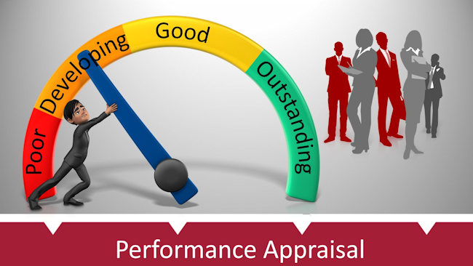

Slide 41

Performance Appraisal is the process of making an assessment of the performance and progress of the employees of an organization.
It is the process of calculating the performance and qualifications of the employees in terms of the requirements of job for which he is employed.
Performance appraisal involves at least two parties, the appraiser who does the appraisal and the appraise whose performance is being evaluated

Slide 42

MEANING
It is a systematic evaluation of performances of several employees so that they can understand all abilities of a person and their development and growth.
Performance appraisal is also done in a very systematic manner which includes measuring the pay of employees and comparing it with all plans and targets.

Slide 43

DEFINITION
According to Flippo, “Performance appraisal is the systematic, periodic and an impartial rating of an employee’s excellence in matters pertaining to his present job and his potential for a better job.”
Performance Appraisal (PA) refers to all those procedures that are used to evaluate the
Personality
Performance
Potential of its group members

Slide 44

NEED FOR PERFORMANCE APPRAISAL
Review the performance.
Judge the gap between the actual and desired
Help the management in exercising control.
Diagnose the training and development needs
Clarity of the expectations and responsibilities
Judge the effectiveness of the other human resource functions
Reduce the grievances of the employees
Strengthen the relationship and communication between superior – subordinates and management – employees

Slide 45

SOURCES OF PERFORMANCE INFORMATION
Personal observation
Monthly reports, documentation, correspondence etc.
Feedback (internal and external)
Periodic discussions with employee

Slide 46
PRINCIPLES OF PERFORMANCE APPRAISAL
Single employee is rated by two raters.
Continuous and personal observation of an employee is essential to make effective appraisal.
Rating should be done by an immediate superior in an organization.
Separate department created for effective appraisal.
The rating is conveyed to the concerned employee.

Slide 47
The plus points of an employee should be recognized. At the same time, the minus points should not be highlighted too much.
Management should create confidence in the minds of employees.
Standard for each job should be determined by the management.
Separate printed forms should be used for performance appraisal to each job according to the nature of the job.

Slide 48
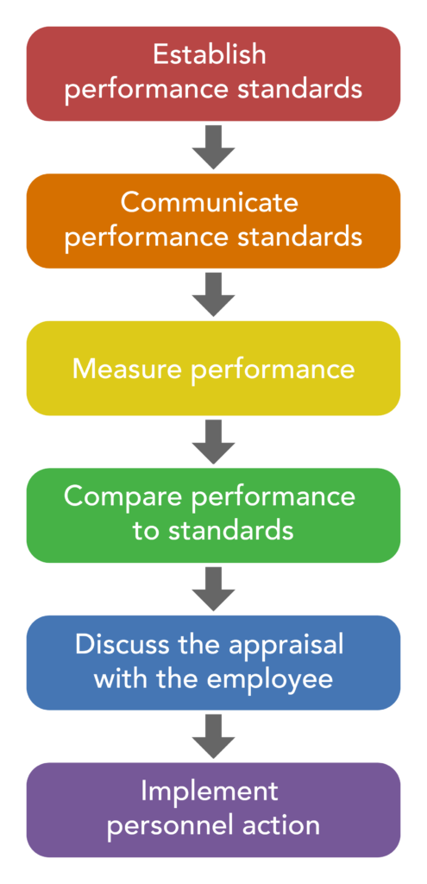
PROCESS OF
PERFORMANCE APPRAISAL

Slide 49

Standards serve as benchmarks against which performance is measured (Pass mark)
It should relate to the desired results of each job (Logical)
Process begins with the setting up of criteria to be used
The criteria should be clear, objective and in writing
It should be discussed with the supervisors to ensure that all the relevant factors have been included.
The output can be measured properly if the criteria is clear.

Slide 50

The appraiser should prepare job descriptions clearly, help appraise set his goals and targets
The appraiser offer coaching and guidance to appraise whenever required
The appraise should be very clear about what he is doing and why

Slide 51

Performance measures, must be reliable, and must report on the critical behaviors that determine performance.
Performance measures may be objective or subjective.
Objective measures are indications of job performance that can be verified by others and are usually quantitative.
Subjective measures are ratings that are based on the personal standards or opinions of those doing the evaluation and are not verifiable by others.

Slide 52

Actual performance may be better than expected one
Sometimes the expected performance may go off the track
Whatever be the consequences, there is a way to communicate and discuss the final outcome.

Slide 53

The results of the appraisal are communicated and discussed with the employees. Along with the deviations, the reasons behind are also analyzed and discussed.
Discussion will enable an employee to know his weakness and strengths
Therefore, he will be motivated and improve himself.

Slide 54

The steps required to improve performance are identified and initiated.
Training, coaching, counseling, etc given that help to improve performance.

Slide 55
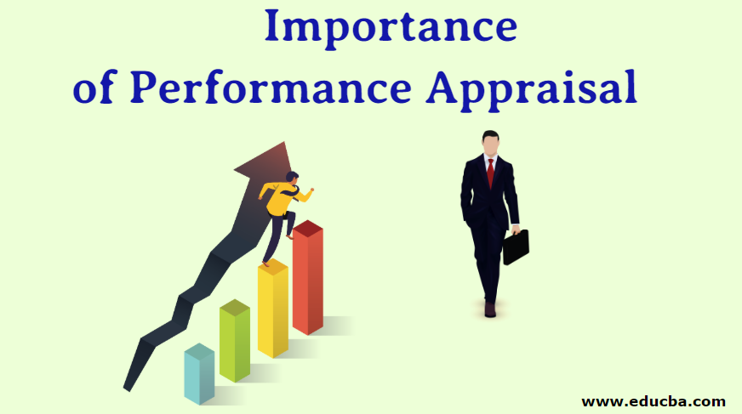
The appraisal boosts the morale of the employees
It motivates them to work more
It help to analyze an individual’s performance and their role
It is the best way to identify the weak areas and the strength areas of the employee.
It establishes a merit-based system that motivates the employees to put their best forward
Conti……

Slide 56
It provide a systematic approach for reaching out to the management for clearing out expectations and to have discussions about future plans.
It is a effective way to promote employees based on their performances.
It is used to scale the level of contribution of employees in the business
It is used to provide fair salary and job rotation

Slide 57
OBJECTIVES OF
PERFORMANCE APPRAISAL
To create and maintain a satisfactory level of performance.
To effect promotions based on competence and performance.
To assess the training and development needs of employees.
To let the employees know where they stand in so far as their performance is concerned.
To improve communication between superior and subordinate.
Conti……

Slide 58
OBJECTIVES OF
PERFORMANCE APPRAISAL
To determine whether HR programs such as selection, training and transfers have been effective or not.
To facilitate fair and equitable compensation based on performance.
To help the superiors to have a proper understanding about their subordinates.
To provide information for making decisions regarding layoff, retrenchment, etc.

Slide 59
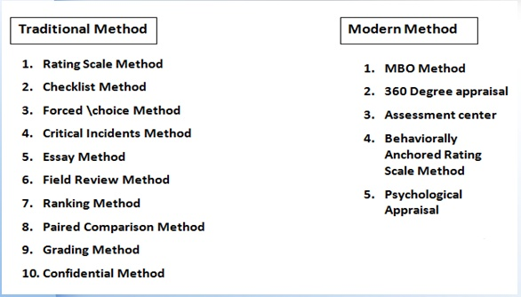
DIFFERENT METHODS OF PERFORMANCE APPRAISAL

Slide 60
RATING SCALE METHOD
This is the simplest popular technique
This consists of several numerical scales, (Likert's)
Each representing a job related performance criterion such as dependability, initiative, output , attendance, attitude, co-operation and the like.
Excellent to poor performance level, and then computes the employees total numerical score.
This method is easy to use, and low cast, large no. of employees can be evaluated in short time.

Slide 61
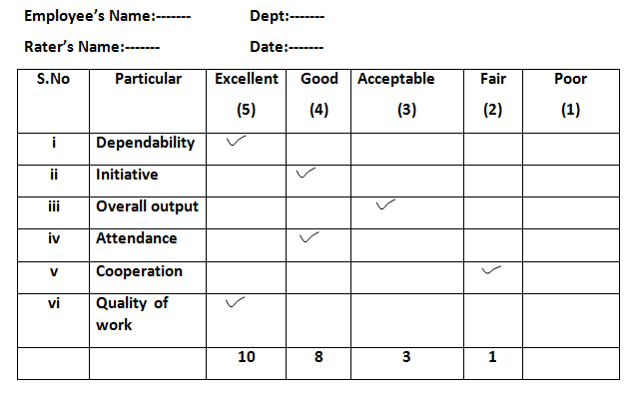

Slide 62
CHECKLIST METHOD
List of statements on the traits of the employee and his job is prepared in two columns, a ‘YES’ column and a ‘NO’ column.
The rater should tick the yes column if the answer positive and in ‘NO’ column if the answer is negative.

Slide 63
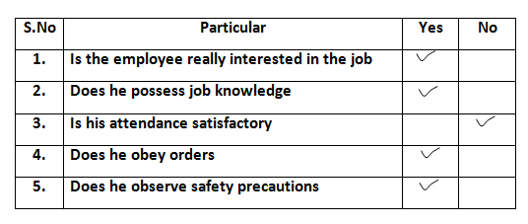

Slide 64
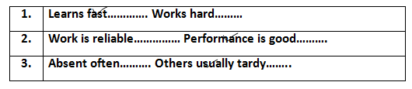
FORCED CHOICE METHOD
The rater is given a series of statements about an employee. These statements are arranged in blocks of two or more.
The rater indicates which statement is most or least descriptive of the employee.
The rater is expected to select the statements that describe the employee.

Slide 65
CRITICAL INCIDENTS METHOD
The evaluator will be asked to record the behavior of different subordinates when a critical incident takes place in the workplace.
Let us assume that P, Q, R, S and T are factory workers and T is involved in an accident while at work and record the reactions of P, Q, R and S and the scores they would get for the same.
This method suitable to measure qualities of individual as Judgment, Alertness, Initiative, Loyalty, etc.

Slide 66
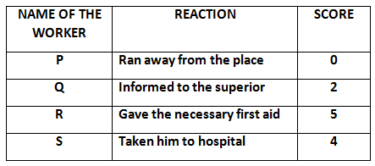

Slide 67
ESSAY METHOD
This traditional form of appraisal, also known as "Free Form method" involves a description of the performance of an employee by his superior.
The description is based on the facts and evidences to support the information.
The rater assesses the employees on certain parameters and writes in his own words,
Work performance in terms of quality and quantity.
Knowledge about the job.

Slide 68
Knowledge about organizational policies, procedures and rules.
Employee’s characteristics and behavior.
Employee’s strength and weakness.
Overall suitability of the employee.
Employee’s potential and promotability.
Training and development needs of the employee.
The rater should have writing skills and analytical ability.

Slide 69
FIELD REVIEW METHOD
Outside the assessor’s own department,
From the corporate office or HR department.
The outsider reviews employee records and holds interviews with the employee and his superior.
This method is suitable for sales executives and service engineers (ex – service engineer)

Slide 70
RANKING METHOD
The superior ranks his subordinates in the order of their merits, starting from the best to worst.
The method resembles the one followed in schools in preparing the progress reports of the students.
The best employee gets the first rank the second best the second rank and so on.
A number of factors like attitudes, aptitude, behavior, honesty, commitment, etc. will have to be considered in making an assessment of an employee’s performance

Slide 71

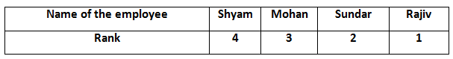
RANKING METHOD

Slide 72
PAIRED COMPARISION METHOD
The appraiser compares each employee with every other employee, one at a time. Ex: there are five employees named A,B,C,D and E.
The performance of A is compared with performance of B and a decision is made about whose performance is better.
Then A is compared with C,D and E in that order. The same procedure is repeated for other employees.

Slide 73
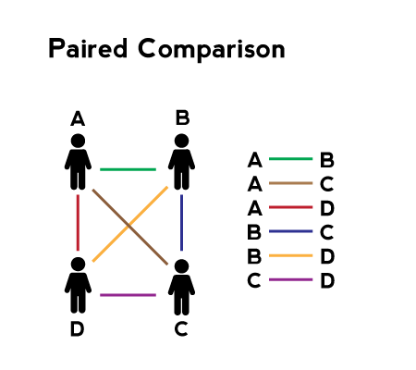

Slide 74
GRADING METHOD
In this method certain categories of abilities are defined well in advance and persons are put in particular category depending on their traits and characteristics
Such categories maybe outstanding, good, average, poor, very poor or maybe in terms of letters like A,B,C,D, etc.
With ‘A’ indicating the best and ‘D’ indicating the worst. The actual performance of the employees is measured against these grades.

Slide 75

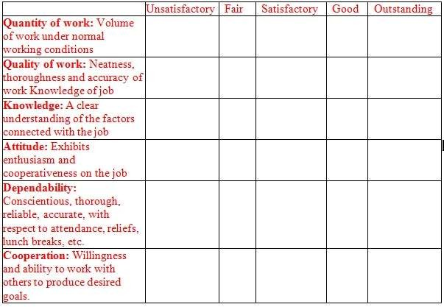



Slide 76
CONFIDENTIAL REPORT
Confidential records are maintained mostly in Government departments. Confidential report ACR shall have 14 items:
Attendance
2.ability to understand
3.initiative
4. self expression
5.ability to reason
6.leadership
7.ability to work with others
8. technical ability
9.originality and resourcefulness
10.Judgment
11. Areas of work that suits the person best
12. Integrity
13.Responsibility
14.Indebtedness

Slide 77
MODERN METHODS - MBO
Management By Objectives, is a process whereby the superior and subordinate managers jointly identify its common objectives.
MBO set goals that are tangible, verifiable and measurable.
The subordinate and superior jointly determine goals to be accomplished
They update and alter goals due to the changes in the business environment.
Ex – car dealer company
Agreed to 40 nos of cars
After one month perodical review (revise the target to 30)
Final review – if achieved – promotion

Slide 78
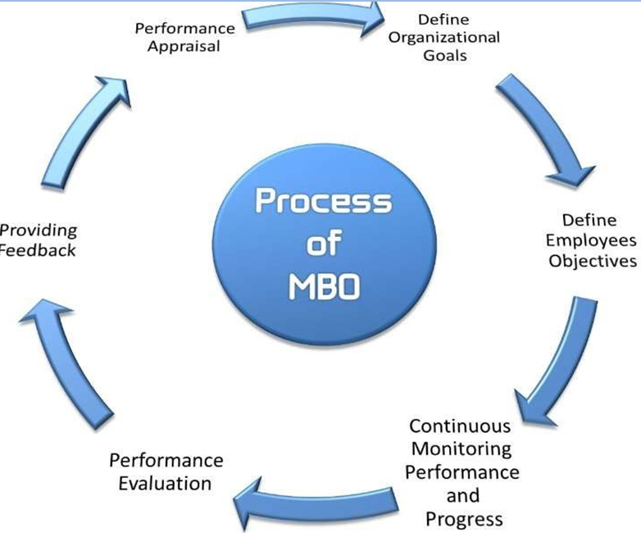

Slide 79

360 DEGREE PERFORMANCE APPRAISAL
Developed by GE of USA in 1992.
Multiple raters are involved
It is a process of systematically gathering data on a person’s skills, abilities and behaviors from a variety of sources
The managers, peers, subordinates, customers clients and outsiders with whom he interacts in the course of his job performance.
The employee’s attributes such as talents, behaviors, values and technical considerations are appraised.

Slide 80
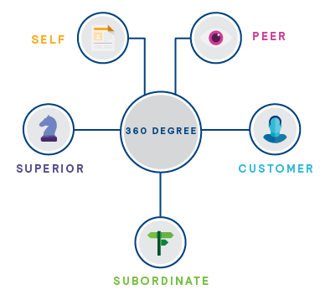

Slide 81
ASSESSMENT CENTER
It is a central location managers come together and participate in a number of simulated exercises evaluated by a panel of raters. The evaluation process goes through 2-3 days.
The characteristics assessed include assertiveness, communicating ability, planning, organizational ability, self confidence, resistance to stress, decision making, administrative ability, creativity and mental alertness.
Ex – leaderless group
The behavior of employees when there is no leader
Employees of same cadre
Superior explains a problem ( pdt is not moving in the market.
MD is arriving within 30 minutes
Monitored by cctv camera

Slide 82


Slide 83
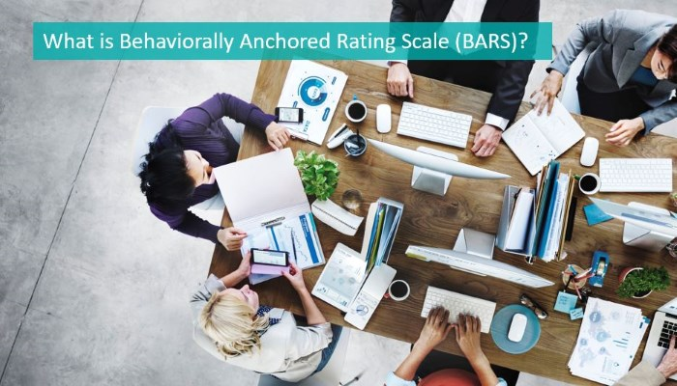
BEHAVIORALLY ANCHORED RATING SCALE
BARs represent a range of descriptive statements of behavior varying from the least to the most effective rater is expected to indicate which behavior on each scale best describes an employee’s performance.

Slide 84
Performance | Points | Behavior
Extremely good | 7 | Can expect trainee to make valuable suggestions for increased sales and to have positive relationships with customers all over the country.
Good | 6 | Can expect to initiate creative ideas for improved sales.
Above average | 5 | Can expect to keep in touch with the customers throughout the year.
Average | 4 | Can manage, with difficulty, to deliver the goods in time.
Below average | 3 | Can expect to unload the trucks when asked by the supervisor.
Poor | 2 | Can expect to inform only a part of the customers.
Extremely poor | 1 | Can expect to take extended coffee breaks and roam around purposelessly.

Slide 85

PSYCOLOGICAL APPRAISAL
Large organizations employ industrial psychologists,
They are used for evaluations, they assess an individuals future potential.
The appraisal normally consists of in depth interviews, psychological tests and discussions.
The psychologist then writes an evaluation of an employee’s intellectual, emotional, motivational and other related characteristics and suggest individual potential future performance.

Slide 86

PSYCHOLOGICAL APPRAISAL
PSYCHOLOGICAL APPRAISAL

Slide 87
PROBLEMS OF PERFORMANCE APPRAISAL
Compare/contrast error
Never compare their abilities to make a judgment.
Each employee is gifted in their unique way,
Has different strengths and weaknesses.
If you compare their abilities, then you will not get a fair review
Some companies rate the employees by comparing their performance with others.

Slide 88
DOING EXCEPTIONALLY WELL
This mainly happens in the sales department.
Person is rude with his co-workers and doesn’t respect anybody, but he is a star salesperson.
He brings more sales for the company, therefore, he is being rated high, irrespective of other drawbacks that he has.

Slide 89
STEREOTYPING
Tend to make judgment by his predetermined mindset towards a particular employee’s race, gender, political affiliation, religious background, culture and other characteristics.
THE HALO EFFECT
The tendency for an impression created in one area to influence opinion in another area.
It is a situation where you let your positive or negative feelings towards an employee to influence your evaluation easily

Slide 90
RECENCY EFFECT – RECENT BEHAVIOUR
All throughout the year the employee has performed really well, but at the end of the year he made a mistake and the rater thinks that he always makes mistake.
He will now be appraised based on this mistake.
On the other hand, this employee was a bad performer all throughout the year, but towards the end he performed exceptionally well in one project, so all his bad performance is forgotten and he ends up getting good ratings.

Slide 91
LENIENCY TENDENCY
This means that some managers are too lenient.
They evaluate all people as outstanding and to give inflated ratings rather than true assessments of performance.
The assessors do not know on what factors that should be given priority. For ex: some may give priority for quantum of work done while others may consider quality of work.

Slide 92
HOW TO MINIMIZES THE PROBLEMS OF PERFORMANCE APPRAISAL
Conduct an open meeting with the appraisers
Explain on what basis employees should be rated(quality or quantity)
Encourage everyone to comment on each other’s achievements and areas requiring improvement.
The appraiser should tell the truth and reality to the management about his subordinates.
Conduct counseling to the employees and tell them the reasons of appraisal and its consequences.

Slide 93
INDUSTRIAL ACCIDENTS
An industrial accident may be defined as “an occurrence which interrupts or interferes with the orderly progress of work in an industrial establishment.
According to the Factories Act of 1948, it is “an occurrence in an industrial establishment causing bodily injury to a person which makes him unfit to resume his duties in the next 48 hours.
Some employees are more accident prone as compared to others. According to T.W. Harell, “Accident proneness is the continuing tendency of a person to have accidents as a result of his stable and persisting characteristics”. If two individuals are working on similar machines under identical circumstances, one may commit more accidents than the other. The former employee will be called an accident-prone operator.

Slide 94
Accidents are undesirable because of both humanitarian and economic reasons. Even a minor accident may bring down the morale of the workers. Whenever an accident occurs, it leads to wastage of time of the employees involved in the accident and that of the organization.
According to T.W. Harell, “Accidents are not only expensive, but they also lower the morale of the workers and in addition result in lower production
Happening of any event which creates the obstacles in the path of smooth conduct of work and the worker is unable to perform his work either temporarily or permanently is called an accident..
Therefore, every occurrence which may injure a worker is not an accident. The injury inflicted on the worker should be serious which makes him unfit to perform his job for the minimum period of two days.

Slide 95
6 PERSONAL CHARATERISTICS CAUSING ACCIDENTS
1. Untrained and unskilled persons are more prone to accidents than trained and skilled ones.
2. Emotionally maladjusted persons are more prone to accidents than emotionally well-adjusted ones.
3. Persons who take unusual risk are more prone to accidents than those who take moderate risk.
4. Alcoholic and drug addict persons are more prone to accidents than those who are away from such vices.
5. Persons who work under stress caused by their personal factors are more prone to accidents than those who do not.
6. Male workers are more prone to accidents than female workers because the latter adopt safety measures with more precaution.

Slide 96
6 MAIN CAUSES OF INDUSTRIAL ACCIDENTS
The expansion, improvement in the existing factories and establishment of the new industries has increased the industrial hazards and accidents.
Accident can take place any time at any place due to little carelessness.
A worker is crushed under the heavy wheels or falls in boiled liquid or the chain of crane gets broken and number of workers die due to various reasons.
Industrial accidents may take place due to the carelessness of workers, defective machinery, dirty and slippery floors, defective lightening system, inadequate training to workers etc.
An accident is an unpleasant, unexpected and sudden incident, yet it does not just happen, it is caused and therefore it is essential to find out if possible specific cause/causes for each particular incident leading to an accident for its future preventions.

Slide 97
CAUSES 1 - TECHNICAL
i) Defective and old machines
ii) Poor maintenance of machines, tools,
iii) Not using the safety guards while working on the machines
iv) No fencing of dangerous machines
v) Lack of good working conditions available to the workers at their work place
vi) Unguarded and improperly adjusted machines
vii) Hazardous arrangement of machines i.e., overcrowding machines
viii) Defective and inadequate safety devices
ix) Unsuitable tools
x) Defective tools i.e. dull, damaged and without handle tools
xi) Inflammable material
xii) Hot and poisonous material.

Slide 98
OTHER TECHNICAL CAUSES
(i) Job Itself – Some jobs are inherently more dangerous and complicated than others, such as the job of crane man in comparison to that of supervisor.
(ii) Work Schedules – The occurrence of accident is also affected by the work schedule. Accidents usually do not occur in the early hours of the work day, but occur late in the day.
(iii) Psychological Climate of Work Place – Psychological climate of the work place also affects the accident rate. According to psychologists, the root causes of accident are psychological, mental, and emotional imbalances.

Slide 99
CAUSES 2 – PSYCOLOGICAL
The second category includes the psychological causes which lead to the accidents in the industry.
Some of these causes are listed below:
(i) Fatigue
(ii) Over work
(iii) Monotony
(iv) Mental disorder
(v) Emotional imbalance
(vi) High anxiety level
(vii) Fear, nervousness, and impulsiveness
(viii) Carelessness.

Slide 100
CAUSES 3 - PERSONAL
The third category of causes of accidents are personal causes which can be listed as follows:
(i) Improper recruitment and selection
(ii) Defective placement
(iii) Carelessness
(iv) Ignorance
(v) Family problems
(vi) Poor relationships with workers, subordinates, and supervisors
(vii) Age
(xiii) Health
(ix) Eye Sight

Slide 101
CAUSES 4 – NON OBSERVANCE
Not using safety equipment
ii) Not observing the measures prescribed by the organization
CAUSES 5 - OTHERS
i) Inability of the workers to grasp the implementation of a process
(ii) Undue haste (unnecessarily quick action)
(iii) Inadequate lightening arrangements
(iv) Excessive noise

Slide 102
CAUSES 6 – UNSAFE ACT
Unsafe acts are the result of lack of knowledge/skill on the part of an employee
(i) Operating without authority .
(ii) Failing to secure equipment.
(iii) Failing to use safe attire or personal protective equipment.
(iv) Throwing materials on the floor carelessly
(v) Operating or working at unsafe speeds, either too fast or too low.

Slide 103
INDUSTRIAL ACCIDENTS - TYPES
Accidents can be of different types. An employee may fall from a height while engaged on a particular assignment, or he may fall against a machine, or parts of machine having a horizontal motion may strike against him, may injure an employee.
This injury may be internal one, e.g., a bone fracture, muscle pull, etc. or external one which shows clearly the signs of injury. Further, both these kinds of injuries may be major or minor.
Minor accident may result in a cut or a scratch, Whereas a major accidents may result in death or disablement.
According to the Workmen’s Compensation Act, 1923, disablement means loss of capacity to work. Disablement of a workman may result in loss or reduction of his or her earning capacity.

Slide 104
Disablement may be partial or total. According to Workmen’s Compensation Act, 1923, partial disablement means any disablement that reduces the earning capacity of a workman as a result of some accident.
Partial disablement may be- (i) permanent, or (ii) temporary. Temporary partial disablement means any disablement that reduces the earning capacity of a workman in any employment in which he was engaged at the time of accident which results in such disablement.
On the other hand, permanent partial disablement is one, which reduces the earning capacity of a workman in every employment, which he was capable of undertaking at the time of injury.
Finally, total disablement, whether of a temporary or permanent nature, this refers to the condition where a workman becomes unfit for every type of work and is not able to get job anywhere due to that disablement

Slide 105
INDUSTRIAL ACCIDENTS
–
4 MAJOR EFFECTS

Slide 106
1. LOSS TO INDUSTRY
(i) Expenditure to be made on the medical treatment of the worker.
(ii) Wages to be paid to the worker for the period when he is not able to join the work due to the injuries caused to him due to the accident.
(iii) Expenses to be made for the services of machines and tools on which the worker is working.
(iv) Expenses to be made for inspection and repairs of the machines and the tools.
(v) Expenses to be incurred on recruitment and training of new worker who has been employed in place of an injured and deceased worker.
(vi) The cost of the period during which other workers to stop working out of fear or out of sympathy with the worker injured by an accident.
(vii) More wages than the normal ones are to be paid on overtime, in case the production work is held up, for honoring the orders of customer in time.
(viii) An accident has also its effect on the other workers. There is a likelihood of occurrence of other accidents out of fear or nervousness.

Slide 107
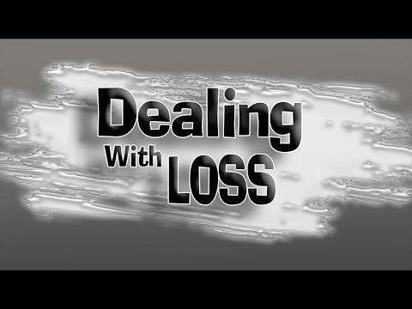
2 . LOSS TO WORKERS
An industry suffers a lot on account of accidents. It affects adversely the worker too. In fact the worker’s loss is far more than the loss of others. Beside the economic loss, worker has also to suffer more badly and in case of his death, his family has no one to help. If he is unable to work after the accident, he becomes a burden for his family. Family losses the source of income and also to bear increased expenses of his treatment.

Slide 108
3. LOSS TO CUSTOMERS
The cost of industrial accident is included in the production cost and therefore, the accidents make an increase in the production cost. This again leads to an increase in the prices of commodities and consumer will not be able to buy according to his need which will also affect the standard of living of the consumers.
4. LOSS TO SOCIETY
If the worker dies or disabled on account of the accident and the worker’s family become helpless and the society has to come to its rescue. The family of such worker has to depend upon the aid of the donation given by the different organizations and it is also a burden on the society.
Accidents not only affect the industry but to the worker, consumer and society. So these accidents should be checked and management should try to reduce these accidents.

Slide 109
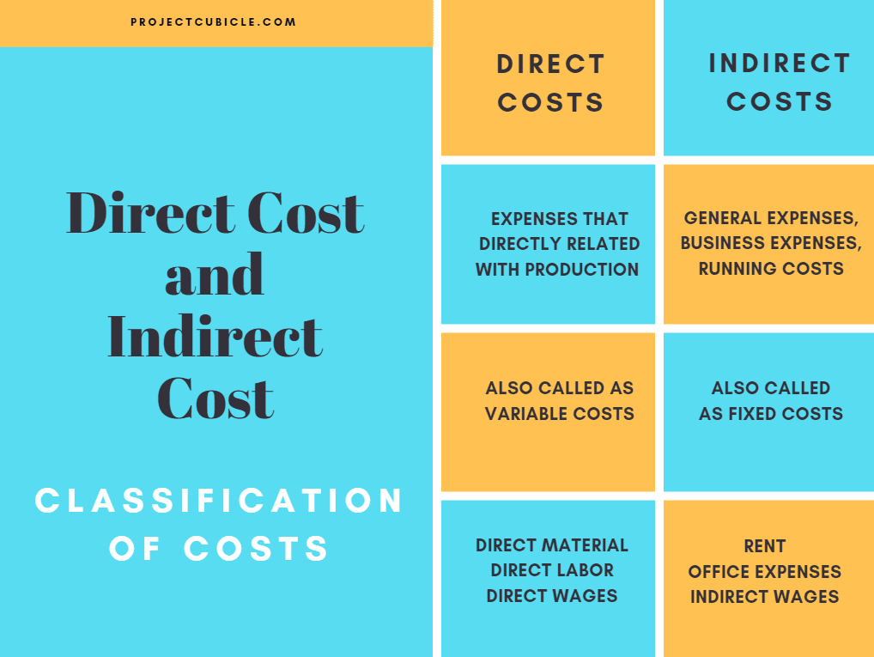
ACCIDENT COSTS: DIRECT COSTS AND INDIRECT COSTS
Accidents are generally costly, both to an employee and to an employer. Some losses are direct and some are indirect. Some losses are visible and some are invisible. From a worker’s point of view, an accident creates pain for him and his family.

Slide 110
From the employer’s context, the accident costs can be divided into two parts
Direct Costs:
These include the following:
(i) Payment of wages to the injured worker during his period of absence due to injury.
(ii) Amount of compensation to be paid on account of death, disablement, etc. The rates are decided as per the provisions of the Workmen’s Compensation Act, 1923 or the Employees’ State Insurance Act, 1948.
(iii) Cost of medical aid.
(iv) Cost of recruiting and training a substitute worker.
(v) Loss in production and quality due to lack of skill and experience of a newcomer.
(vi) Loss due to waste of raw materials.

Slide 111
Indirect Cost
The indirect costs of accidents are estimated to be two to four times the direct costs.
The indirect costs are the following:
(i) Cost of lost time of injured employee.
(ii) Cost of time lost by other employees who stop work out of curiosity and sympathy, to assist the injured employee, etc.
(iii) Cost of time lost by foremen, supervisors in assisting the injured employee, investigating the cause of the accident, arranging for the injured employee’s production to be continued by some other employee, recruitment, selection and training of the new employee, preparing state accident reports or attending hearings before industrial commissioner, etc.
(iv) Cost of time spent on the case by first-aid attendant and hospital staff when this is not covered by insurance.

Slide 112
The indirect costs of accidents are estimated to be two to four times the direct costs.
The indirect costs are the following:
(i) Cost of lost time of injured employee.
(ii) Cost of time lost by other employees who stop work out of curiosity and sympathy, to assist the injured employee, etc.
(iii) Cost of time lost by foremen, supervisors in assisting the injured employee, investigating the cause of the accident, arranging for the injured employee’s production to be continued by some other employee, recruitment, selection and training of the new employee, preparing state accident reports or attending hearings before industrial commissioner, etc.
(iv) Cost of time spent on the case by first-aid attendant and hospital staff when this is not covered by insurance.

Slide 113
Prevention of Accidents
Prevention of Accidents
1. The Safety Programme:
Once the management develops interest in promoting safety measures, then it should plan the safety programme.
(i) Support by Top Management:
Top Management’s support was characterized by personal attendance at safety meetings, periodic personal inspections, and insistence on regular safety reports, company’s board of director’s meetings.
(ii) Appointing a Safety Director:
The next step is to appoint a safety director who shall be given the primary responsibility for the installation and maintenance of the safety programme. In small organization this job can be assigned to any responsible line manager. However, in case of a larger organization, director/safety engineer is usually appointed.

Slide 114
(iii) Engineering a Safe Plant and Operation:
Factory should be kept clean, properly ventilated and free from dust. All dangerous parts of machines and equipment should be properly fenced.
(iv) Educating All Employees to Act Safely:
A good safety programme should have proper provision for educating the employees to act, think and work safely.
This can be done through the following:
(a) Educating the new employees at the time of induction.
(b) Giving emphasis on safety points during training periods especially during the off-the-job training

Slide 115
(c) Making of special efforts by first level supervisor.
(d) Establishment of employee safety committees.
(e) Holding of employee safety meetings.
(f) Use of company periodical, if any.
(g) Use of charts, posters and displays emphasizing the need to act safely.
(v) Record Keeping:
The employer should maintain a proper record showing the number of accidents, occupational illnesses and the number of lost workdays.

Slide 116
(vi) Accident Analysis:
Even after taking all the preventive measures, accidents occur. They should be thoroughly investigated in terms of both costs and causes.
(vii) Safety Contests:
Safety contests stimulate employees to think and act safely. It has been observed that accident rate is lower in the pre-contest and during the contest period but once the period of contest is over the accident rates goes up again.
(viii) Enforcement:
A safety programme should be enforced rigorously only then the desired results can be obtained. Although the basic approach of a safety programme should be positive in nature, yet in some cases the negative approach by way of imposing fines, discharge, lay-offs, etc. may also be necessary to enforce discipline in case someone deliberately violates the safety rules and instructions.

Slide 117
Following safety measures should be adopted
Following Safety measures should be adopted
1. Engineering Approach:
These measures are related to the defects of machines and equipment and the defective atmosphere of work in the factory.
To overcome these defects, an engineer can make the following contributions:
(i) To Cover Moving and Dangerous Parts:
An engineer inspects machines and plants of the factory and provides lattice to the moving or rotating parts of the machines.
(ii) Arrangement of Guards:
Often the workers make an access to the danger zones during operations and get entangled while passing by the machines. In order to avoid some accidents the engineer makes arrangements of guards around the machine through a framework of metal strips.

Slide 118
(iii) Replacement of Dangerous Machines:
Safety manager has the proper knowledge of new changes as well as the new and safer machines, so he has to make proposal to the manager for replacing the dangerous machines with new and safer machines.
(iv) Arrangement of Safety Devices:
The engineers can guide the workers who are working on dangerous machines to make arrangements for safety devices. Tight fitting clothing for workers working by the side of dangerous machines should be provided.
(v) Improvement in Operations:
The engineer can make an improvement in the operation of the machines by regularly inspecting machines and equipment of the factory.

Slide 119
(vi) Arrangement of Fire Equipment:
There are more chances of breaking out of fire in the factory and sometimes fire in the factory becomes a cause of major and dangerous accidents. Such accidents can be minimized by arranging for fire equipment in the factory.
2. Psychological Approach:
An engineer can only think the ways for improving the machines, equipments, and working conditions. All this reduces only a small part of accidents. Eighty per cent accidents are the result of the human defects.

Slide 120
A Psychologist can take the following steps in providing the safety measures
(i) Proper Selection:
Most of the accidents in the factory are due to the reasons that the workers do not take interest in the work or afraid of operating a machine or they do not follow the instructions. Such worker should not be allowed to work in the factory. Only qualified, experienced, and attentive workers should be allowed to work on machine.
(ii) Proper Placement:
Worker should be placed on the job keeping in mind the nature, interest, and experience of the worker regarding the job. Worker should not be appointed at a place where they don’t want to work because if it is done, he will not take interest in his work.
(iii) Convincing of Importance of Safety:
Each and every worker should be provided full and proper knowledge of safety. Worker should know the importance of safety and management must make continuous efforts for motivating workers to do their job with utmost safety.

Slide 121
(iv) Training:
training is provided to the workers regarding their work in the factory but management should take care of them and only trained workers should be allowed to operate upon machinery.
(v) Motivating Safety Habit:
Management should make continuous efforts for motivating the workers to do their job with utmost safety. Provision should also be made for awarding reward to the workers who make record of safety and make regular use of safety measures to those who make concrete proposal for safety in the factory.
(vi) Strict Rules:
Rules meant for the use of safety methods and for prohibiting the untrained workers from causing any disturbance to the machines in the factory should strictly enforced. And provisions should also be made for the worker who violates these rules. Safety rules should be strictly enforced in the factory.

Slide 122

INDUSTRIAL SAFETY
Industrial safety refers to the management of all operations and events within an industry in order to protect its employees and assets by minimizing hazards, risks, accidents, and near misses.

Slide 123
SAFETY IN INDIA UNDER FACTORIES ACT 1948
The Factories Act, 1948, insists that the following preventive measures must be adopted in industrial establishments:
1. Cleanliness: Every factory should be kept clean and free from effluvia - from drain and privy refuse, and from dirt. It should be whitewashed at least once in 14 months or painted at least once in five years. Floors should be cleaned, at least once every week, with some disinfecting fluid.
2. Disposal of Wastes and Effluents: Effective arrangements should be made for their disposal and/or treatment.
3. Ventilation and Temperature: Provision should be made for the circulation of fresh air, and temperature should be maintained by building walls and roofs of such materials as would keep it within reasonable limits. High temperature may be controlled by whitewashing, spraying and insulating the factory premises and by screening outside walls, roofs and windows.

Slide 124
4. Dust and Fumes: Effective measures should be taken to prevent, reduce, the inhalation and accumulation of dust and fumes. Exhaust appliances should be used near the point of the origin of dust and fumes.
5. Lighting: Sufficient and suitable lighting, natural or artificial or both should be made available in the factory premises,
6. Overcrowding: No room should be overcrowded. There should be sufficient space for every worker.
7. Drinking Water: A sufficient quantity of cool drinking water should be made available for the employees throughout the year, particularly during the hot summer months.
8. Latrines and Urinals: Adequate latrines and urinals should be separately provided for men and women employees.
9. First Aid Appliances: There should be an adequate number of boxes containing first aid materials, qualified personnel to administer first aid, and an ambulance or at least a room where an injured employee may be given first aid.
Safety Officer: where 500 or more workers employed in factory, there should be safety officer

Slide 125
ROLE OF SAFETY OFFICER IN THE ORGANISATION
To formulate safety procedure, safety policy, safety requirements and standard of the company.
· To act as chairman or secretary or, in any other capacity on the works safety committees.
· To promote formation of such committees, where they do not exist. · To administer safety suggestion schemes.
· To organize safety education, training, publicity at various levels of companies operations

Slide 126
· To investigate the causes of industrial injuries and the circumstances leading to accidents.
· To act in close liaison with governmental and non-governmental agencies.
· To co-ordinate the safety effort of the company in every possible way.
· To assess critically the safety performance of the organization and if necessary, conduct safety training programmes and feedback sessions on an ongoing basis.
·

Slide 127
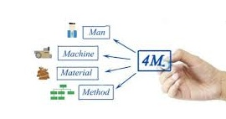
PLANT LAYOUT
Plant layout is the most effective physical arrangement, i.e arrangement of machines, processing equipment and service departments to achieve greatest co-ordination and efficiency of 4M’s (Men, Materials, Machines and Methods) in a plant.

Slide 128
DEFINITION :
According to James Lundy, “Layout identically involves the allocation of space and the arrangement of equipment in such a manner that overall operating costs are minimized.”
In the words of Mallick and Gandreau, “Plant layout is a floor plan for determining and arranging the designed machinery and equipment of a plant, in the best place, to permit the quickest flow of material, at the lowest cost and with the minimum handling in processing the product, from the receipt of raw material to the shipment of finished product.”

Slide 129
According to Apple, “Plant layout is planning the path each component/part of the product is to follow through the plant, coordinating the paths of the various parts so that the manufacturing processes may be carried out in the most economical manner, then preparing drawing or other representation of the arrangement and finally seeing that the plan is properly put into effect.” (Plant Layout and Material Handling by Apple).
In the words of Sansonneti and Mallick (Factory Management, Vol. 103) “It is placing the right equipment, coupled with right place, to permit the processing of a product unit in the most effective manner, through the shortest possible distance and in the shortest possible time

Slide 130
OBJECTIVES OF GOOD LAYOUT
(i) Should provide overall satisfaction to all concerned. i.e. shareholders, management, employees and consumers.
(ii) Material handling and internal transportation from one operation to the next is minimized and efficiently controlled.
(iii) The congestions are to be eliminated so that input raw materials and semi-finished parts move fast from one work station to another.

Slide 131
(vi) Should provide worker’s convenience, promote job satisfaction and safety for them.
(vii) Should avoid unnecessary investment of capital.
(viii) Should help in effective utilization of labour.
(ix) Should lead to increased productivity and better quality of the product with reduced capital cost.
(x) Should provide easy supervision.
(xi) Should provide space for future expansion of the plant.
(xii) Should provide proper lighting and ventilation of the areas of work stations

Slide 132
NEED FOR PLANT LAYOUT
(i) There are design changes in the product.
(ii) There is an expansion of the enterprise.
(iii) There is proposed variation in the size of the departments.
(iv) Some new product is to be added to the existing line.
(v) Some new department is to be added to the enterprise and there is reallocation of the existing department.

Slide 133
FACTOR AFFECTING PLANT LAYOUT
Whatever be the type of layout being contemplated the following factors are to be considered
(i) Man Factor:
(i) Safety and working conditions.
(ii) Man power requirements-skill level of workers, their number required and their training program
(iii) Man power utilization in the plant.

Slide 134
(ii) Material Factor:
It includes the various input materials like raw materials, semi-finished parts, finished products, packing materials, tools and other services.
The main considerations are:
(i) Design and specifications of the product to be manufactured.
(ii) Quantity and variety of products and materials.
(iii) Physical and chemical characteristics of various inputs materials.
(iv) Component parts or material and their sequence of operations i.e. how they go together to generate the final product.

Slide 135
(iii) Machinery Factor:
(i) The processes and methods should be standardized first.
(ii) Machinery and tools selections depend upon the type of process and method, so proper machinery and other supporting equipment should be selected on the basis of volume of production.
(iii) Equipment utilization depends on the variation in production, requirements and operation
(iv)Machines should be used,to their optimum levels of speed, feed and depth of cut.
(v) Machinery requirement is mostly based on the process/method.
(vi) Maintenance of machines and replacement of parts is also important.

Slide 136
(iv) Movement Factor:
It mainly deals with the movement of men and materials. A good layout should ensure short moves and should always tend towards completion of product. It also includes interdepartmental movements and material handling equipment.
(v) Waiting Factor:
Whenever material or men is stopped, waiting occurs which costs money.
The important considerations in this case are:
(a) Location of storage.
(b) Method of storing.
(c) Space for waiting.
(d) Safeguard equipment for storing and avoiding delay.

Slide 137
(vi) Service Factor:
It includes the activities and facilities for personnel such as fire protection, lighting, heating and ventilation etc. Services for material such as quality control, production control, services for machinery such as repair and maintenance and utilities like power, fuel/gas and water supply etc.
(vii) Building Factor:
It includes outside and inside building features, shape of building, type of building (single or multi-storey) etc.

Slide 138
TYPES OF PLANT LAYOUT
1. Product or Line Layout.
2. Process or Functional Layout.
3. Fixed Position Layout.
4. Combination type of Layout.

Slide 139
PRODUCT / LINE LAYOUT
If all the processing equipment and machines are arranged according to the sequence of operations of a product, the layout is called product type of layout. In this type of layout, only one product or one type of products is produced . This product must be standardized and produced in large quantities.
The raw material is supplied at one end of the line and goes from one operation to the next quite rapidly with a minimum work in process, Fig. 3.3 shows product layout for two types of products A and B.

Slide 140
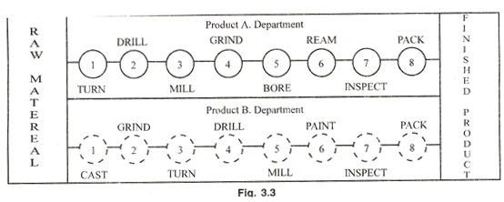

Slide 141
Advantages
(i) Lower total material handling cost.
(ii) There is less work in process.
(iii) Better utilization of men and machines.
(iv) Less floor area is occupied by material in transit and for temporary storages.
(v) Greater simplicity of production control.
(v) Total production time is also minimized.
Limitation
i) A single machine breakdown may shut down the whole production line,
ii) Specialized and strict supervision is essential.

Slide 142
PROCESS / FUNCTIONAL LAYOUT
The process layout is particularly useful where low volume of production is needed. In this type of layout the machines are not arranged according to the sequence of operations but are arranged according to the nature or type of the operations.
This layout is commonly suitable for non-repetitive jobs. Same type of operation facilities are grouped together such as lathes will be placed at one place all the drill machines are at another place and so on.
See Fig. 3.4 for process layout. The process carried out in any area is according to the machine available in that area.

Slide 143
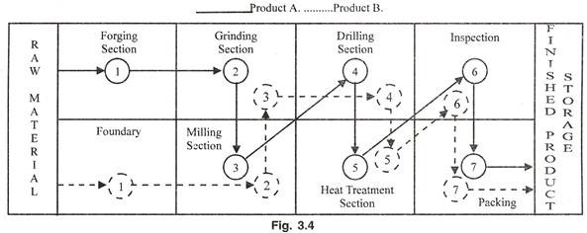

Slide 144
Advantages of Process Layout:
(i) It offers better and more efficient supervision through specialization at various levels.
(ii) There is a greater flexibility in equipment and man power thus load distribution is easily controlled.
(iii) Better utilization of equipment available is possible.
(iv) Breakdown of equipment can be easily handled by transferring work to another machine/ work station.

Slide 145
Limitations of Process Layout:
(i) There are long material flow hence it is expensive
(ii) Total production cycle time is more owing to long distances and waiting at various points.
(iii) Generally more floor area is required.
(iv) work does not flow through definite lines, counting and scheduling is more tedious.

Slide 146
FIXED POSITION LAYOUT
In this type of layout the major component remain in a fixed location, other materials, parts, tools, machinery, manpower and other supporting equipment are brought to this location.
The major component or body of the product remains in a fixed position because it is too heavy or too big and it is economical and convenient to bring the necessary tools and equipment’s to work place along-with the man power. This layout is used in the manufacture of boilers, hydraulic and steam turbines and ships etc.

Slide 147
Advantages
(i) Material movement is reduced
(ii) Capital investment is minimized
(iii) The task is usually done by gang of operators, hence continuity of operations is ensured
(iv) Effective planning and loading can be made. Thus total production cost will be reduced .
Limitations
(i) Highly skilled man power is required.
(ii) Movement of machines equipment’s to production centre may be time consuming.
(iii) Complicated fixtures may be required for positioning of jobs and tools. This may increase the cost of production.

Slide 148
COMBINATION TYPE OF LAYOUT
layouts used in industries are the compromise of the above mentioned layouts. Every layout has got certain advantages and limitations therefore, industries would not like to use any type of layout as such.
Flexibility is a very important factor, so layout should be, which can be moulded according to the requirements of industry, without much investment. If the good features of all types of layouts are connected, a compromise solution can be obtained which will be more economical and flexible.

Slide 149
ADVANTAGES OF GOOD LAYOUT
To the Worker:
Reduces the effort of the worker.
Extends the process of specialization.
Produces better working conditions by eliminating congestions.
Reduces the number of accidents.
Provides better employee service facilities/conditions.
Provides basis for higher earning for employees.

Slide 150
Manufacturing Costs:
Reduces the cost of expensive supplies.
Decreases maintenance costs.
Decreases tool replacement costs.
Decreases spoilage and scrap. Thus waste is minimized
Improves the quality of the product by decreasing handling.
Provides better cost control.

